Slide 1

Visit Bangladesh

Slide 2
Submitted By
S.M Shahriyar ( BSSE 1044)
Sudip Kumar Sah ( BSSE 1040)
Supervised By
Sumon Ahmed
Assistant Professor
Institute of Information Technology

Slide 3
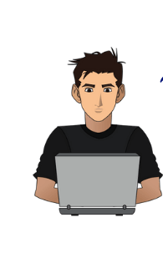

Are you a Traveler ? Want to get Proper Information before visiting a tourist Place ?
Search in Facebook Groups
Search in Google
কিভাবে যাবো
কই যাবো
খরচ কেমন
But unfortunately cannot get proper information

Slide 4
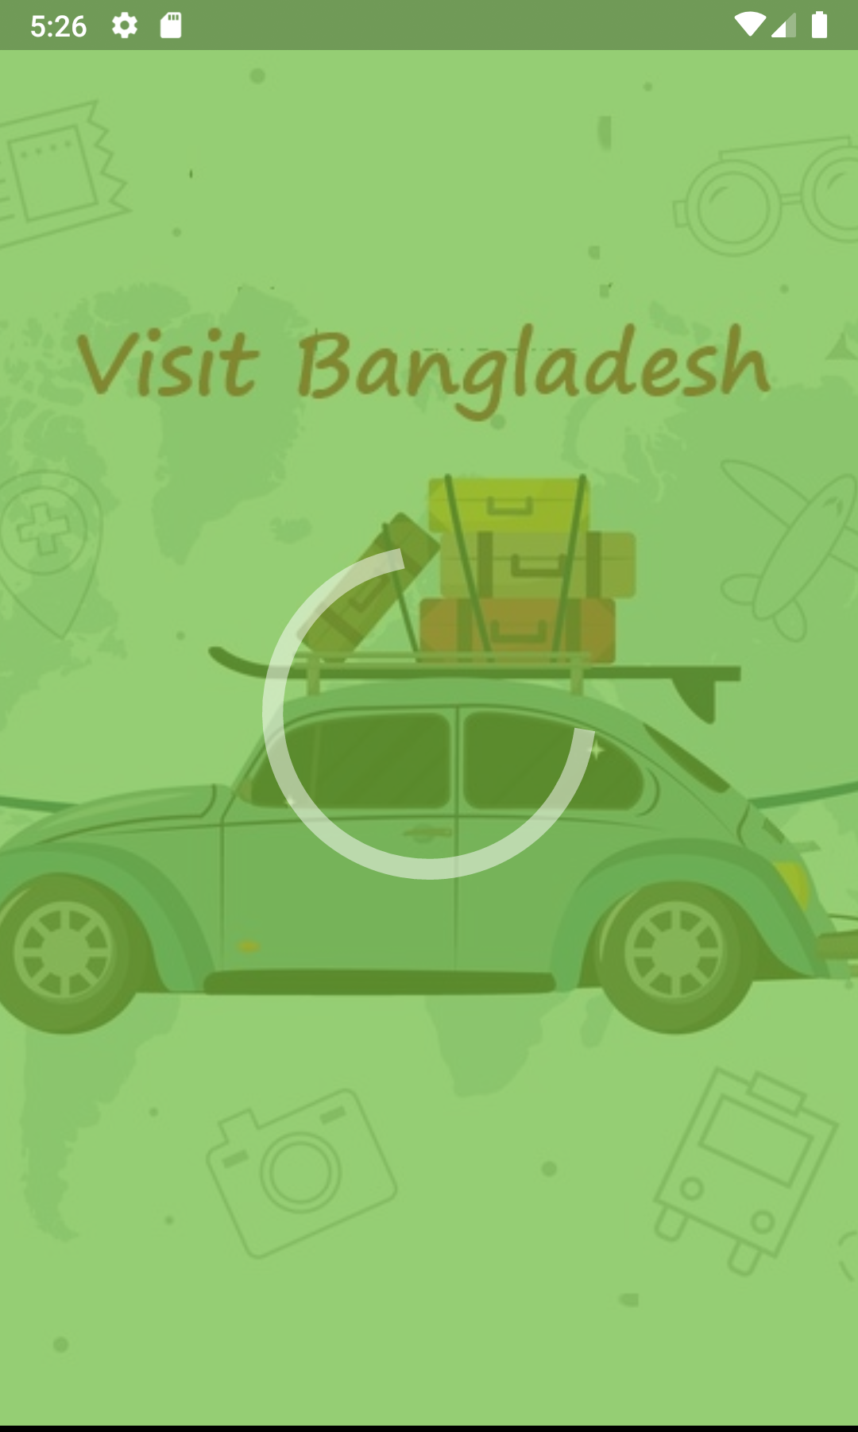


Here is the Solution for you -
Visit
Bangladesh
Visit Bangladesh
Android App

Slide 5
Motivation
Useful for travel lovers as well as general people.
Tourists from other countries use this app easily to visit Bangladesh.
Anyone can get idea about the beauty of Bangladesh by this app.
The project is android based aims at the development of Tourism Sector of Bangladesh.

Slide 6


Why Visit Bangladesh Application
Let’s
See the App Features

Slide 7
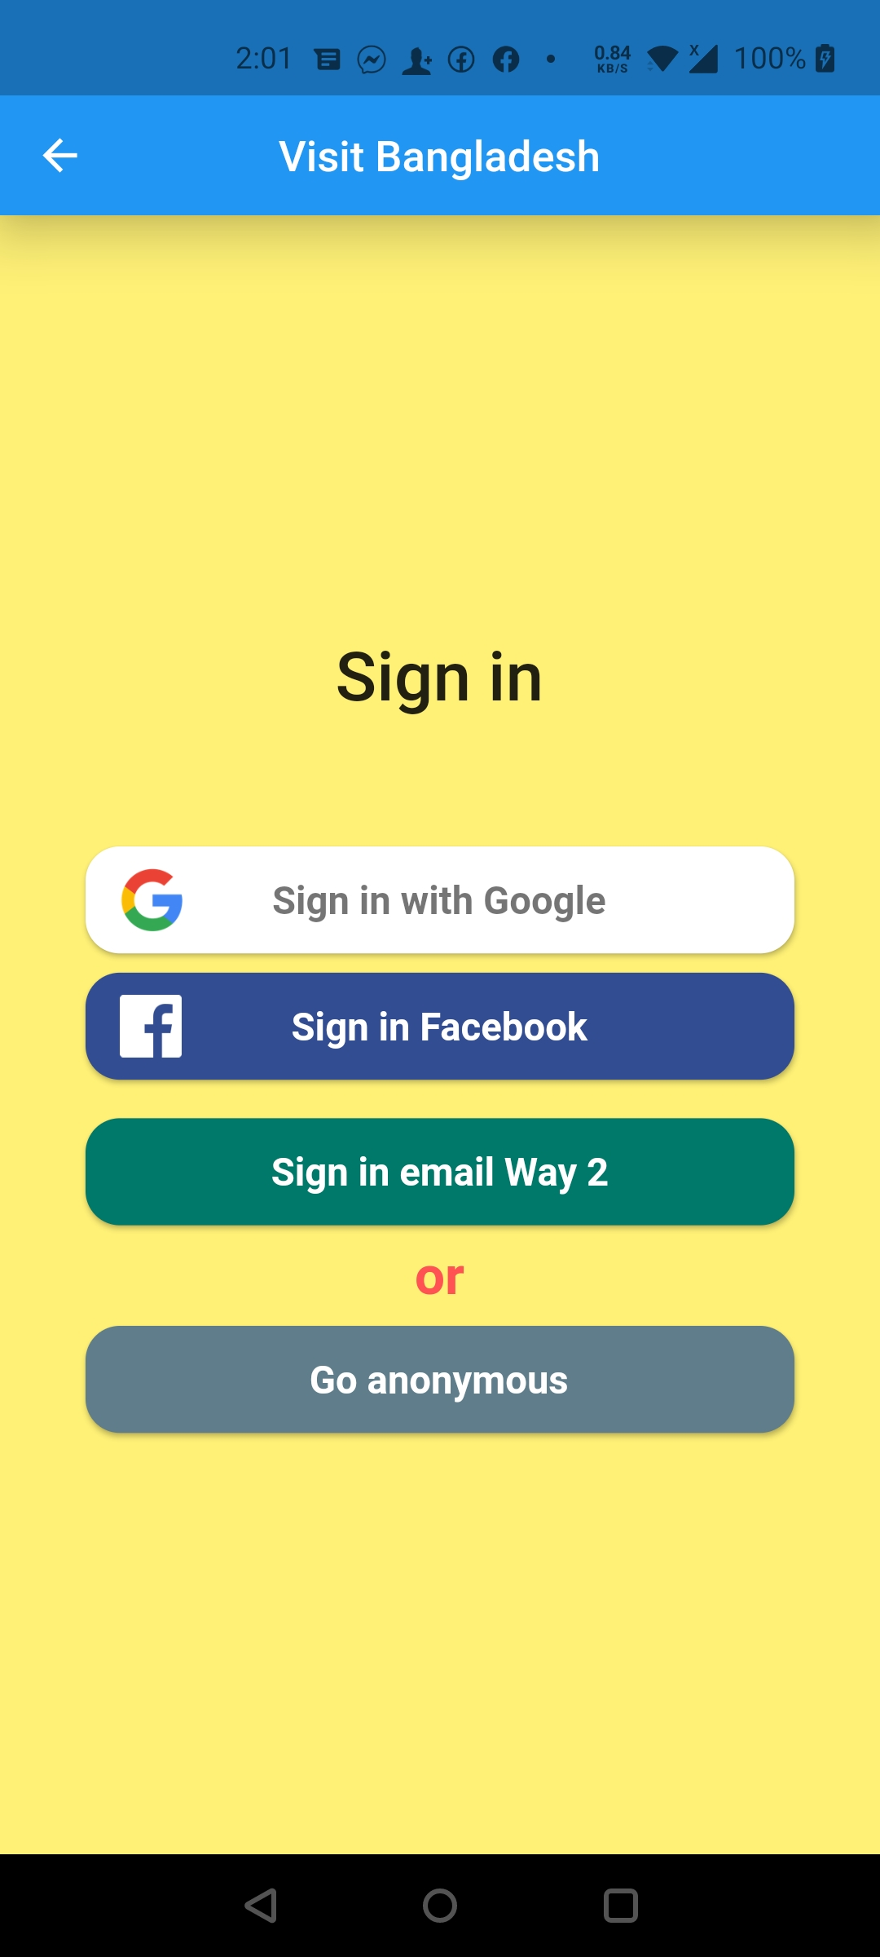
Authentication
Have opportunity for different type of Login or Sign Up

Slide 8
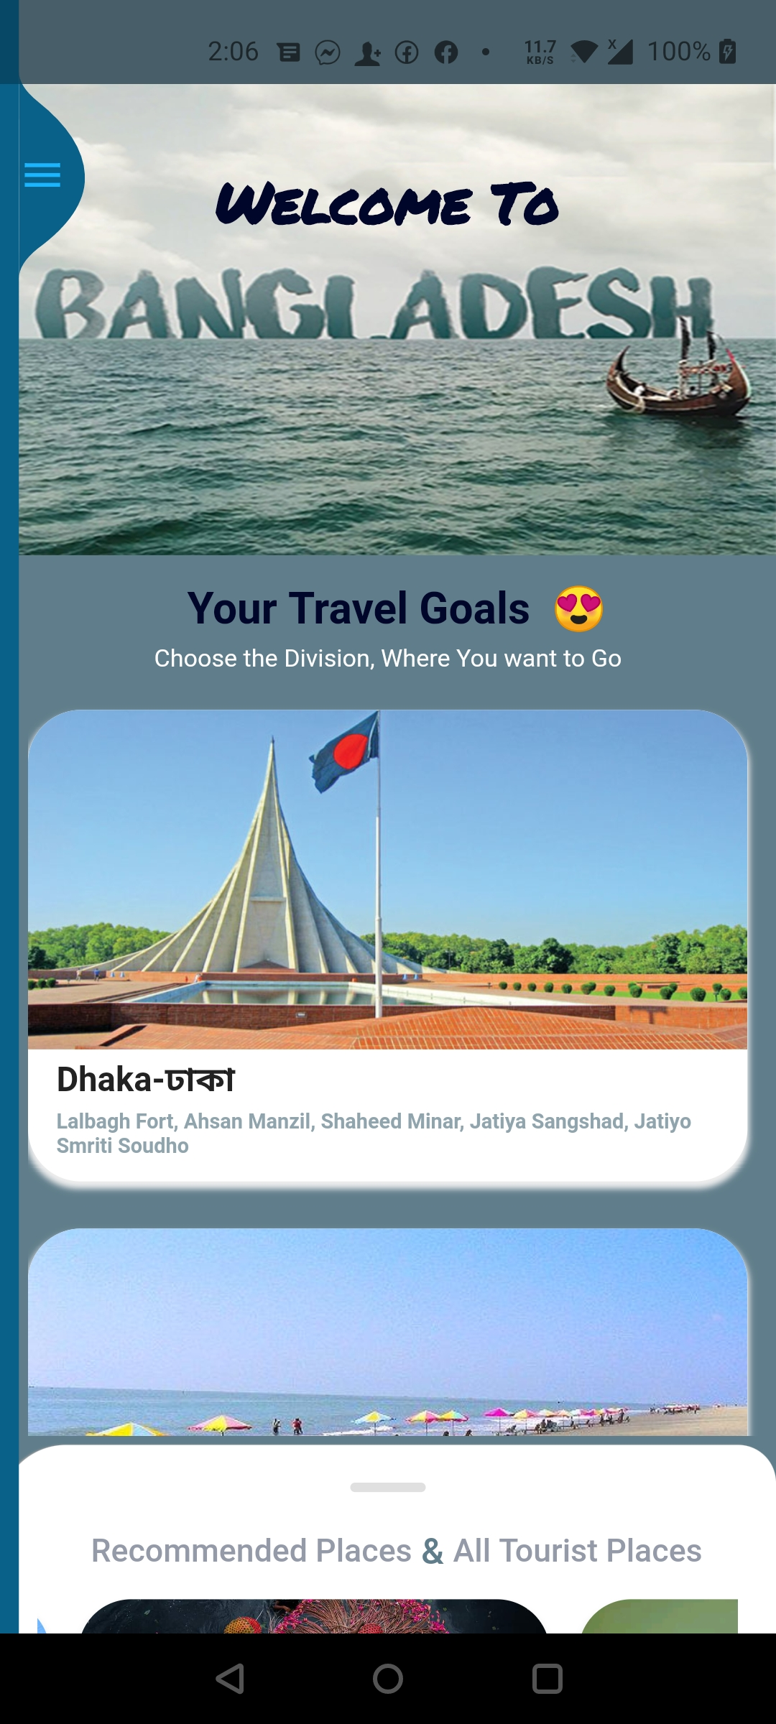
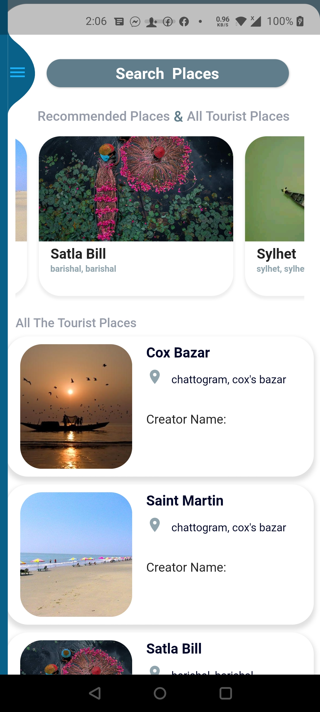
Welcome Home Page
Have opportunity to find places through Division wise or by Searching

Slide 9
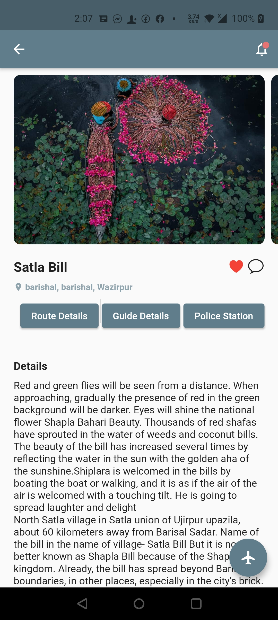
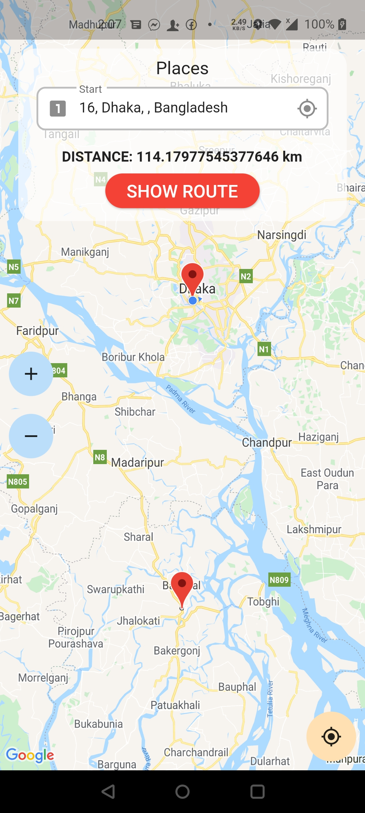
Place Details
Have opportunity to find almost all the necessary information and route details

Slide 10
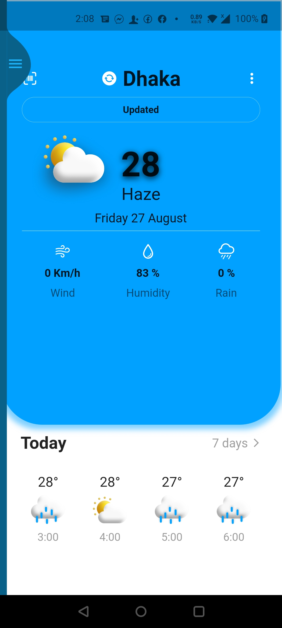
Weather Update
Worry about weather
No worry, Visit Bangladesh is here for you……..
Check place weather first, then decide
To Go

Slide 11
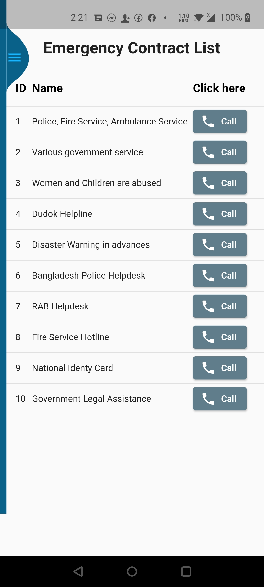
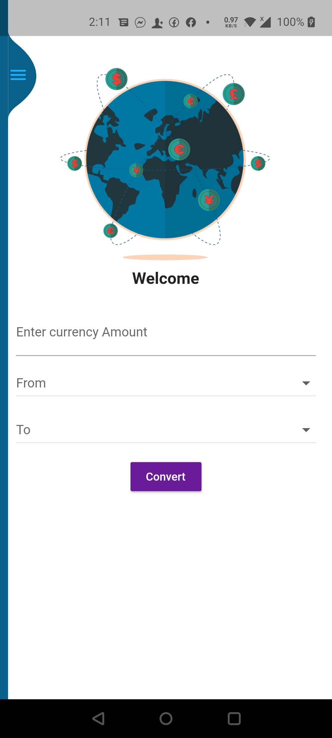
Currency Converter & Emergency Contract List
You are in trouble or need help ?
Just click the call button
Or are you a foreigner ?
Here is the currency converter for you….

Slide 12
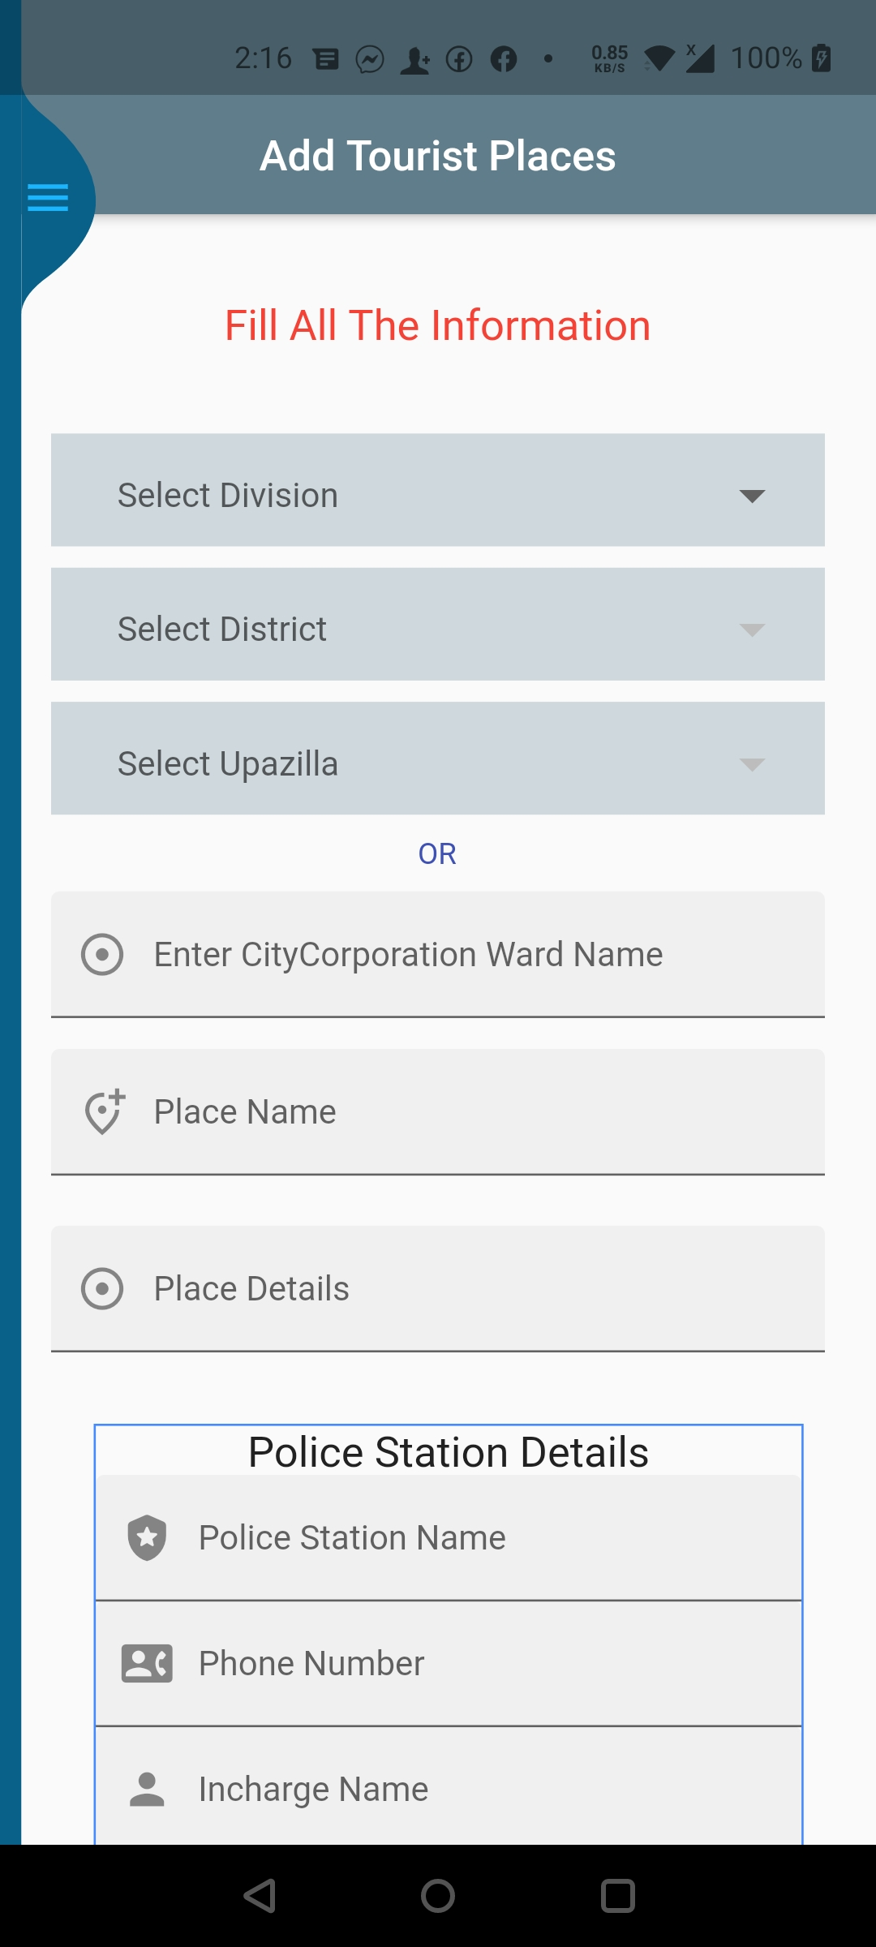
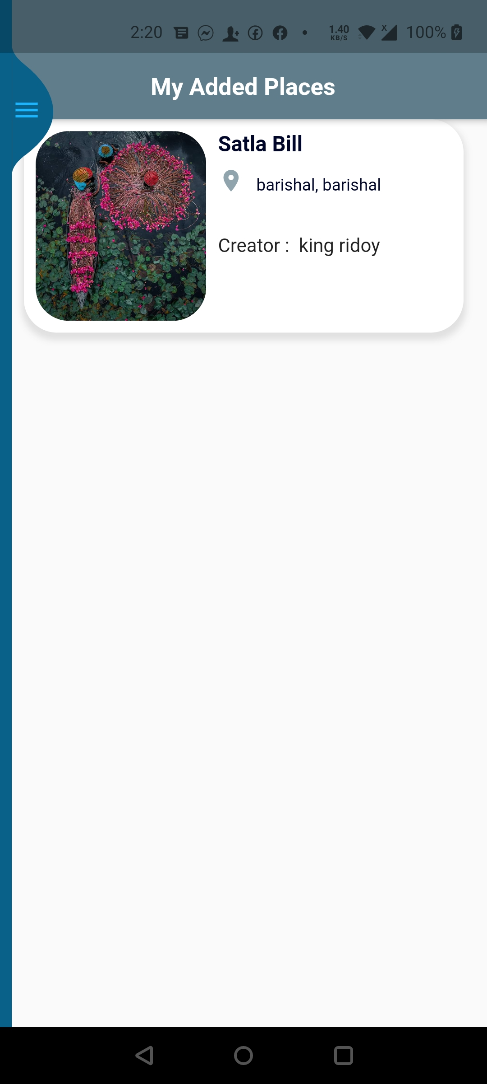
Add Place and See Yours
As a Traveler you can add new places and See your added places……

Slide 13

For more details
=> Let’s see the application demonstration

Slide 14
Install Visit Bangladesh and Explore
So What are you Thinking ?
🤔
🤟

Slide 15
THANKS!
Any questions?

